Slide 1
Explanation-Based Learning

Slide 2
Analogical Reasoning
Learning by Recording Cases
Case-Based Reasoning
Explanation-Based Learning
Analogical Reasoning

Slide 3
Lesson Preview
Concept space
Prior knowledge
Abstraction
Analogical transfer

Slide 4
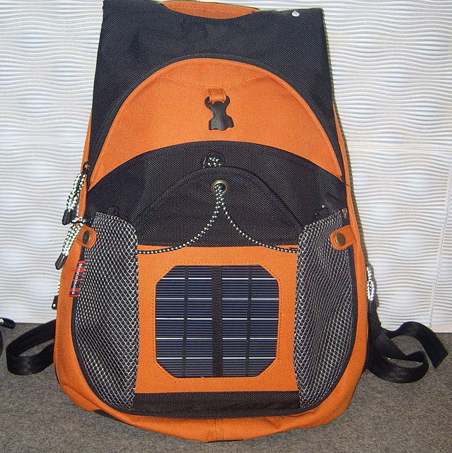
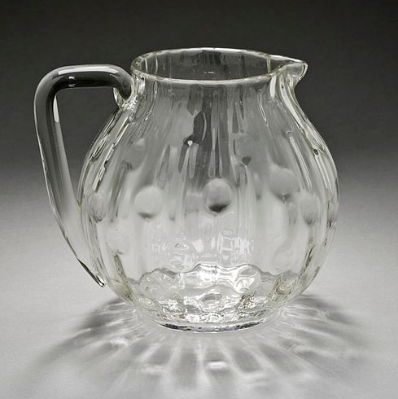
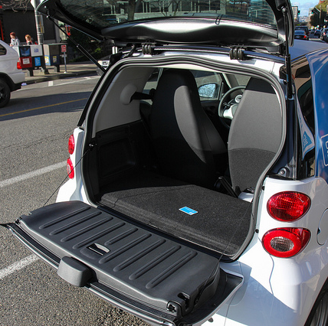
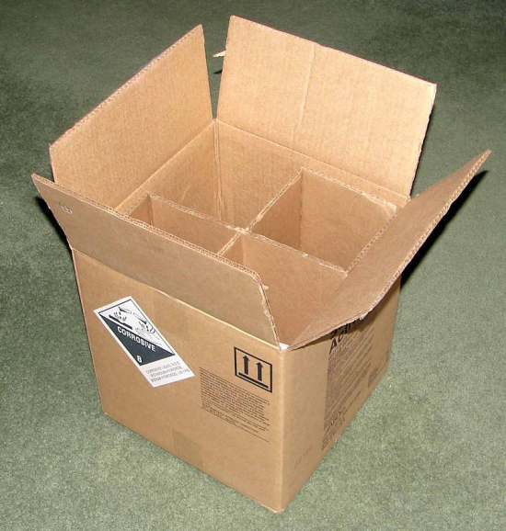
Which of these might be useful for transporting soup from the kitchen to the table?
ο
ο
ο
ο
Notes:
Image credit
Rico Shen, https://commons.wikimedia.org/wiki/User:BrockF5
Atomic Taco, https://secure.flickr.com/photos/atomictaco/8376082216/

Slide 5
A Cup
A cup is an object that is stable and enables drinking.
An Object
This object is light and made of porcelain. It has a decoration, a concavity, and a handle. The bottom is flat.
Can we prove this object is a cup?

Slide 6
is
Object
Cup
has
Object
Bottom
is
Bottom
Flat
made-of
Object
Porcelain
has
is
has
Object
Concavity
Object
Light
Object
Decoration
has
Object
Handle

Slide 7
Prior Knowledge
A Brick
The brick is stable because its bottom is flat. A brick is heavy.
A Glass
The glass enables drinking because it carries liquids and is liftable. It is pretty.
A Briefcase
The briefcase is liftable because it has a handle and is light. It is useful because it is a portable container for papers.
A Bowl
The bowl carries liquids because it has a concavity. The bowl contains cherry soup.

Slide 8
A Brick
The brick is stable because its bottom is flat. A brick is heavy.
Brick
is
Brick
Stable
has
Brick
Bottom
is
Bottom
Flat
is
Brick
Heavy

Slide 9
A Briefcase
The briefcase is liftable because it has a handle and is light. It is useful because it is a portable container for papers.
Briefcase
is
Briefcase
Liftable
is
Briefcase
Light
has
Briefcase
Handle
is
Briefcase
Useful
is
Briefcase
Portable

Slide 10
A Bowl
The bowl carries liquids because it has a concavity. The bowl contains cherry soup.
Bowl
carries
Liquids
Bowl
has
Bowl
Concavity
has
Bowl
Cherry Soup

Slide 11
A Glass
The glass enables drinking because it carries liquids and is liftable. It is pretty.
Glass
enables
Glass
Drinking
is
Glass
Liftable
carries
Liquids
Glass
is
Glass
Pretty

Slide 12
Bowl
carries
Liquids
Bowl
has
Bowl
Concavity
has
Bowl
Cherry Soup

Slide 13
Bowl
carries
Liquids
carries
Liquids
Bowl
Object
has
has
Bowl
Concavity
Object
Concavity
has
Bowl
Cherry Soup

Slide 14
is
Object
Cup
has
Object
Bottom
is
Bottom
Flat
made-of
Object
Porcelain
has
is
has
Object
Concavity
Object
Light
Object
Decoration
has
Object
Handle

Slide 15
is
Object
Cup
has
Object
Bottom
is
Bottom
Flat
carries
Bowl
Object
Liquids
made-of
Object
Porcelain
has
is
has
Object
Concavity
Object
Light
Object
Decoration
has
Object
Handle

Slide 16
is
Object
Cup
has
Object
Bottom
is
Bottom
Flat
carries
is
Object
Liquids
Briefcase
Object
Liftable
made-of
Object
Porcelain
has
is
has
Object
Concavity
Object
Light
Object
Decoration
has
Object
Handle

Slide 17
is
Object
Cup
Glass
enables
Object
Drinking
has
Object
Bottom
is
Bottom
Flat
carries
Liquids
is
Object
Object
Liftable
made-of
Object
Porcelain
has
is
has
Object
Concavity
Object
Light
Object
Decoration
has
Object
Handle

Slide 18
is
Object
Cup
is
enables
Brick
Object
Drinking
Object
Stable
has
Object
Bottom
is
Bottom
Flat
carries
Liquids
is
Object
Object
Liftable
made-of
Object
Porcelain
has
is
has
Object
Light
Object
Object
Concavity
has
Concavity
Object
Decoration
has
Object
Handle

Slide 19
Cup
is
Object
Cup
is
enables
Object
Stable
Object
Drinking
has
Object
Bottom
is
Bottom
Flat
carries
Liquids
is
Object
Object
Liftable
made-of
Object
Porcelain
has
is
has
Object
Concavity
Object
Light
Object
Decoration
has
Object
Handle

Slide 20
is
Object
Cup
is
enables
Object
Stable
Object
Drinking
has
Object
Bottom
is
Bottom
Flat
carries
Liquids
is
Object
Object
Liftable
made-of
Object
Porcelain
has
is
has
Object
Concavity
Object
Light
Object
Decoration
has
Object
Handle

Slide 21
A Mug
A mug is an object that is stable, enables drinking, and protects against heat.
A Pot
The pot carries liquids because it has a concavity. It limits heat transfer because it has thick sides and is made of clay.
An Object
This object is light and made of clay. It has a concavity and a handle. The bottom is flat, and the sides are thick.
Can we prove this object is a mug?

Slide 22
A Mug
A mug is an object that is stable, enables drinking, and protects against heat.
A Pot
The pot carries liquids because it has a concavity. It limits heat transfer because it has thick sides and is made of clay.
An Object
This object is light and made of clay. It has a concavity and a handle. The bottom is flat, and the sides are thick.
Can we prove this object is a mug?
ο Yes ο No

Slide 23
is
Object
Mug
protects
against
is
enables
Object
Stable
Object
Drinking
Object
Heat
Pot
limits
Object
Heat transfer
has
Object
Thick sides
made-of
Object
Clay

Slide 24
What knowledge would finish our proof that this object is a mug?
ο A Serving Plate
The serving plate protects against heat because it is made of clay and is shaped like an oval.
ο A Wooden Spoon
The spoon is long and made of wood. It protects against heat because it has a handle.
ο An Oven Mitt
The oven mitt is made of cloth. It protects against heat because it limits heat transfer.
ο A Baking Dish
A baking dish protects against heat because it is made of porcelain and has a handle.

Slide 25
is
Object
Mug
protects
against
is
enables
Oven Mitt
Object
Stable
Object
Drinking
Object
Heat
limits
Object
Heat transfer
has
Object
Thick sides
made-of
Object
Thick sides

Slide 26
is
Object
Mug
protects
against
is
enables
Wooden Spoon
Object
Stable
Object
Drinking
Object
Heat
has
Object
Handle

Slide 27
Assignment
How would you use explanation-based learning to design an agent that could answer Raven’s progressive matrices?

Slide 28
To recap…
Concept space
Prior knowledge
Abstraction & transfer

